Slide 1


AUTOMATED VERIFICATION
Group 4
Team members:
Nguyen Minh Duc - TALENT 12
Tran Minh Tuan - TALENT 56
Final Lab Presentation
1

Slide 2

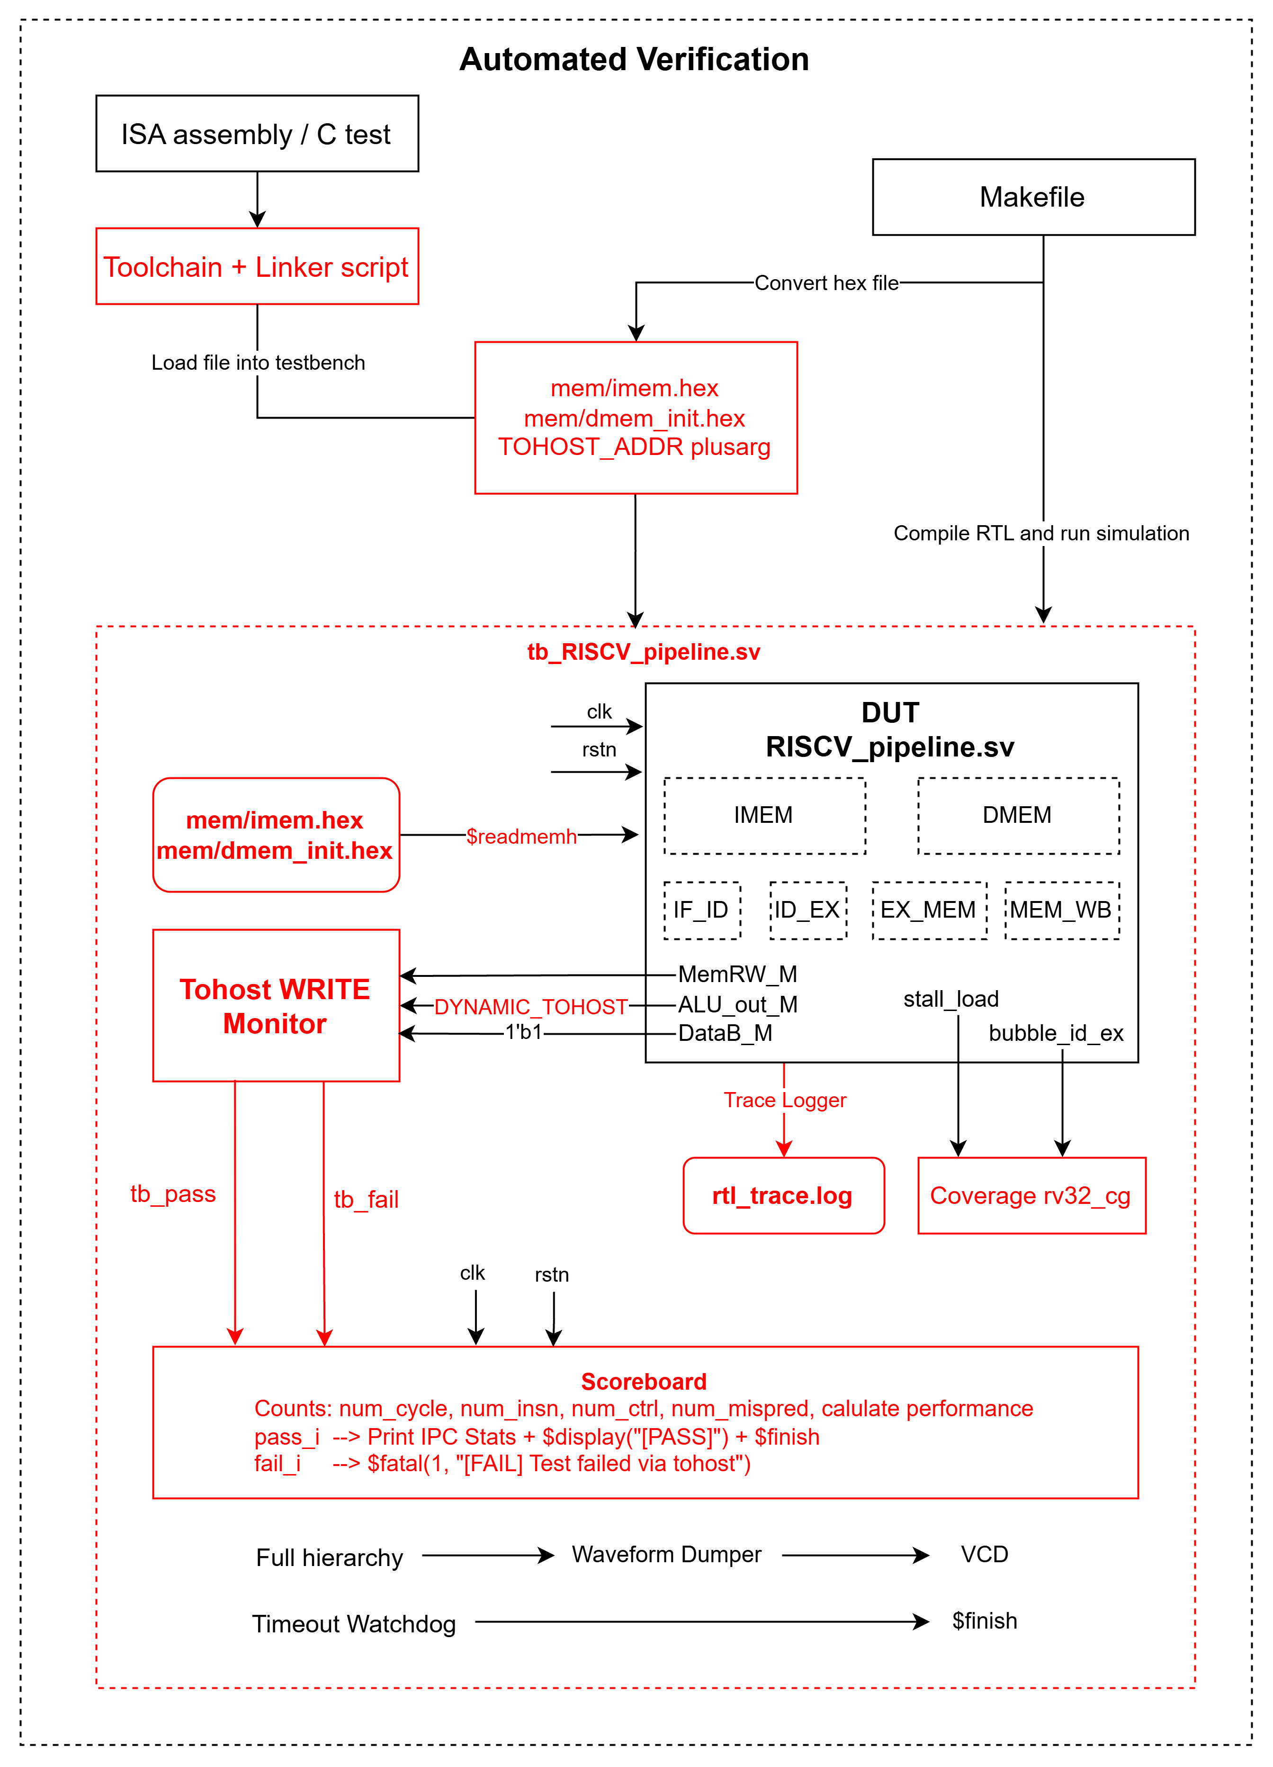
1. Objective & System Architecture
• Project Objective
Create an automated flow that can run a regression suite on RV32I RISC-V Pipelined CPU.
Produce clear checkers, expected-vs-actual comparisons, and failure messages.
Produce logs, regression summary, coverage, and performance metrics.
• Scope
RV32I RISC-V Pipelined CPU from previous lab manuals.
IMEM and DMEM.
Functional and microarchitectural verification for the RTL simulation environment.
2
FINAL LAB – Automated Verification – Group 4
1
FINAL LAB — RV32I Project Presentation

Slide 3
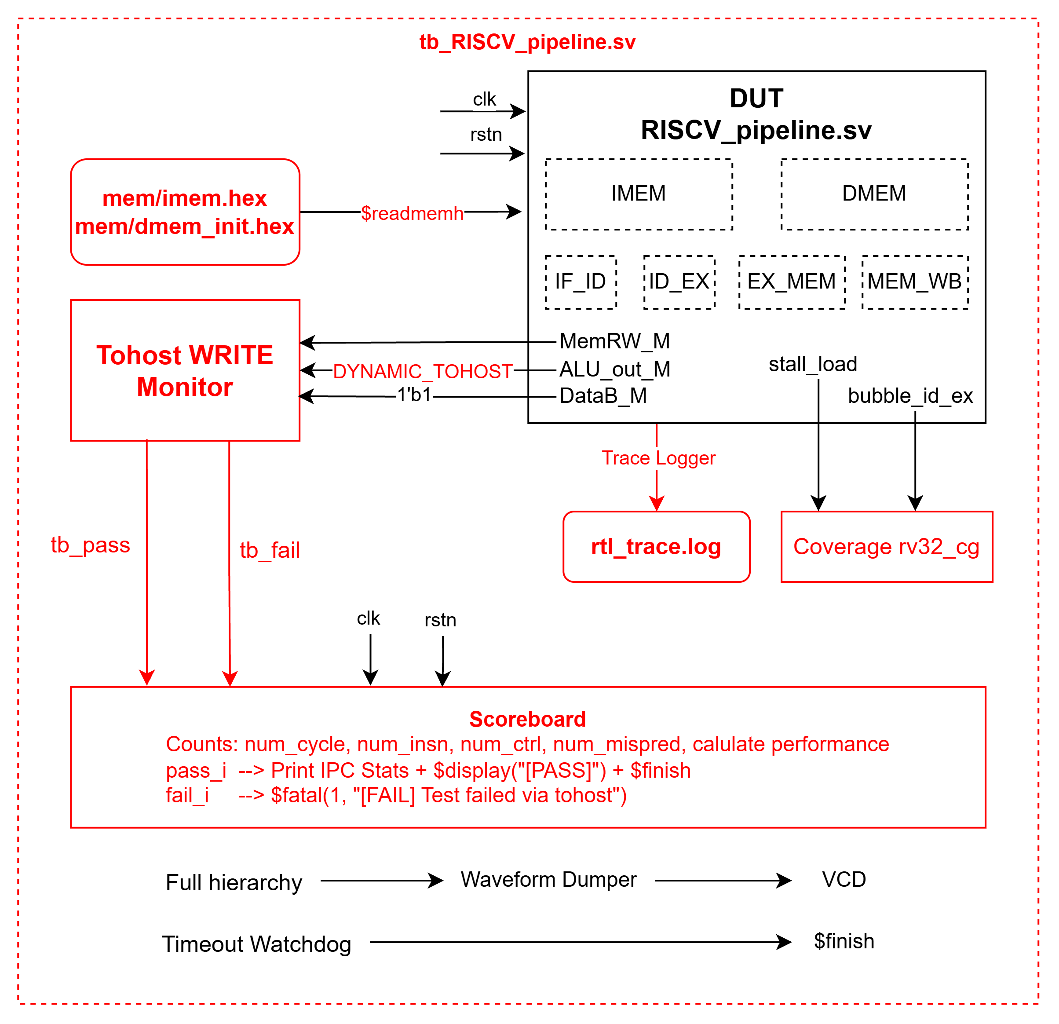
2. Implementation
Hardware
DUT: 5-stage pipelined RISC-V CPU.
clk and rstn: System clock and asynchronous active-low reset signals.
Memory: Load from generated hex files.
Pipeline: Observes the connection between stages as registers.
Hazard coverage: Tracks stall/load and pipeline bubbles.
Completion checking: Monitors tohost writes to determine test PASS/FAIL.
Trace logging: Records CPU execution activity in rtl_trace.log.
Scoreboard: Tracks down performance metrics.
Waveform dumping: Captures full-hierarchy signals in a VCD file for debugging.
Timeout watchdog: Automatically stops simulations that do not complete.
3
FINAL LAB – Automated Verification – Group 4
2
FINAL LAB — RV32I Project Presentation

Slide 4
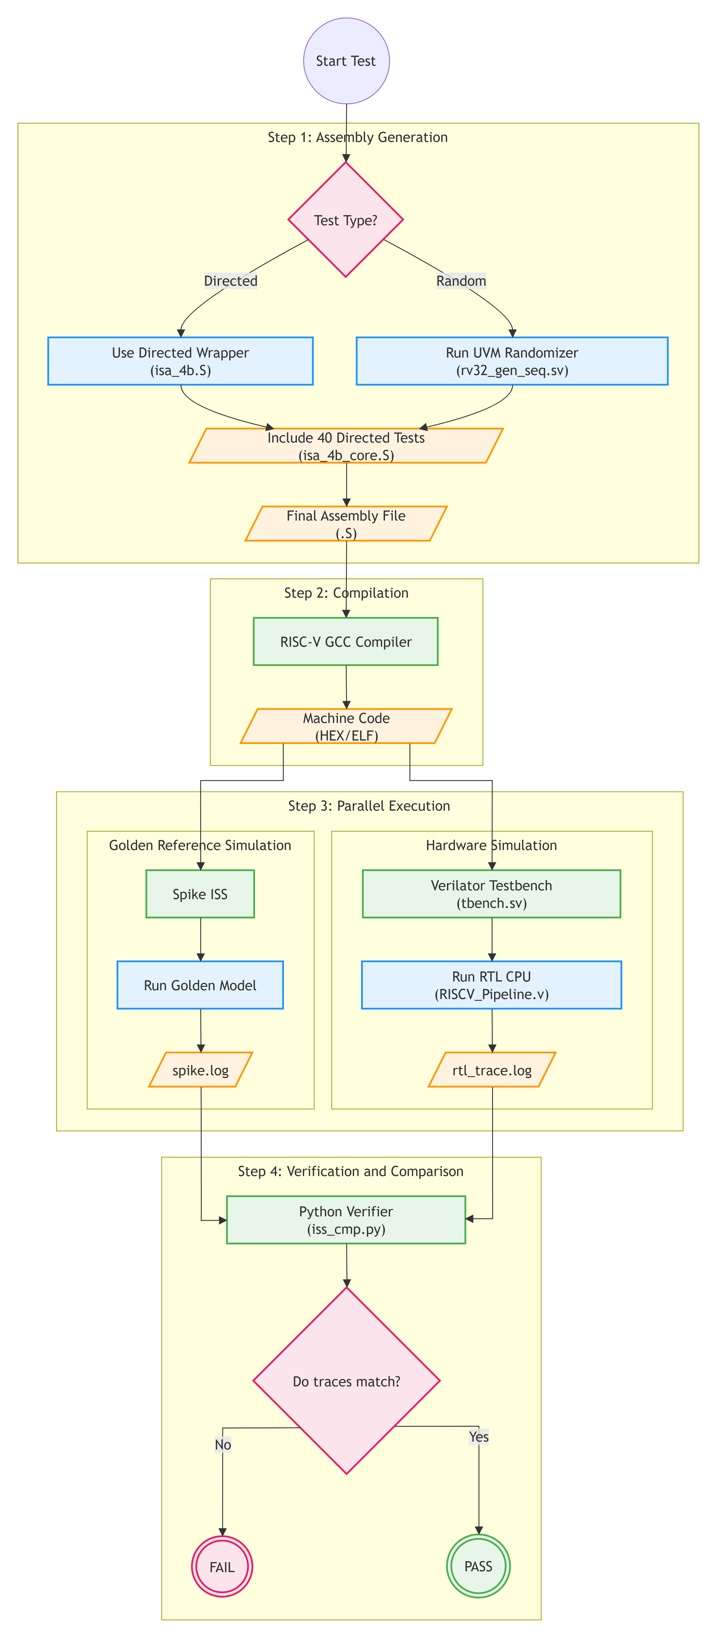
2. Implementation
Software / Integration
Test Generation and Compilation Flow
Start the test
  Initialize the verification flow and select the test type.
Select test type
  Directed: Use the directed test wrapper, isa_4b.S.
  Random: Generate constrained-random instructions using the UVM sequence, rv32_gen_seq.sv.
Build the test program
  Add the 40 directed ISA tests from isa_4b_core.S.
  Combine the wrapper or random sequence with the common test set.
Generate final assembly
  Produce the complete RISC-V assembly test file, .S.
Compile the test
  Use the RISC-V GCC compiler to translate the assembly program.
Generate machine code
  Output the executable test image in HEX/ELF format for RTL simulation.
3
FINAL LAB – Automated Verification – Group 4
2
FINAL LAB — RV32I Project Presentation

Slide 5
2. Implementation
Software / Integration
Parallel Execution and Verification Flow
Start parallel execution
  Run the golden reference and RTL hardware simulations using the same machine code.
Run the golden model
  Execute the test program on Spike ISS.
  Save the reference execution trace to spike.log.
Run the RTL simulation
  Launch the Verilator testbench using tbench.sv.
  Simulate the pipelined CPU in RISCV_pipeline.v.
  Save the RTL execution trace to rtl_trace.log.
Compare execution traces
  Use the Python verifier, iss_cmp.py, to compare spike.log and rtl_trace.log instruction by instruction.
Check verification result
  Verify that register updates, program counters, instructions, and relevant architectural states match.
Report PASS or FAIL
  PASS: All trace entries match with zero differences.
  FAIL: Any trace mismatch, missing instruction, unexpected state, or incomplete simulation.
3
FINAL LAB – Automated Verification – Group 4
2
FINAL LAB — RV32I Project Presentation

Slide 6
3. Verification Plan
Test / Scenario | Stimulus / Method | Expected Result / Reference | PASS/FAIL Evidence
[TC1] Basic function | • Directed assembly tests • Compile with RISC-V GCC • Run using make run_isa4b | • Self-checking test program • Correct ISA execution | • PASS: tohost = 1 • FAIL: tohost = 0 or mismatch • Evidence: Simulation log and scoreboard
[TC2] Corner case | • Constrained-random and directed tests • Test alignment, limits, and edge values | • RTL matches Golden Model (Spike ISS) • Edge-value coverage bins are hit | • PASS: Zero trace mismatches • FAIL: Any RTL/Spike mismatch • Evidence: iss_cmp.py and functional coverage
[TC3] Stress / random | • Random valid instruction sequences • Multiple seeds and long regressions • Run using make run_random | • Instruction-by-instruction match with Golden Model (Spike ISS) • Program terminates normally | • PASS: 100% trace match and normal completion • FAIL: Mismatch, illegal state, or unexpected stop • Evidence: Regression log and coverage report
[TC4] Protocol / hazard | • Inject data and control dependencies • Exercise forwarding, stalls, jumps, and branches | • Correct forwarding and pipeline stall/flush behavior • RTL matches Golden Model (Spike ISS) | • PASS: Zero mismatches and hazard coverage hit • FAIL: Wrong result, missing stall/flush, or mismatch • Evidence: Trace comparison, waveform, and coverage
Global Timeout / Deadlock Criteria
Timeout FAIL: Simulation exceeds the configured MAX_CYCLES without a valid tohost completion.
Deadlock FAIL: No instruction retirement or program-counter progress for DEADLOCK_CYCLES.
Immediate FAIL: Trace mismatch, assertion failure, illegal state, or tohost = 0.
Final PASS: tohost = 1, zero mismatches, no assertion failures, and completion before timeout.
4
FINAL LAB – Automated Verification – Group 4
3
FINAL LAB — RV32I Project Presentation

Slide 7
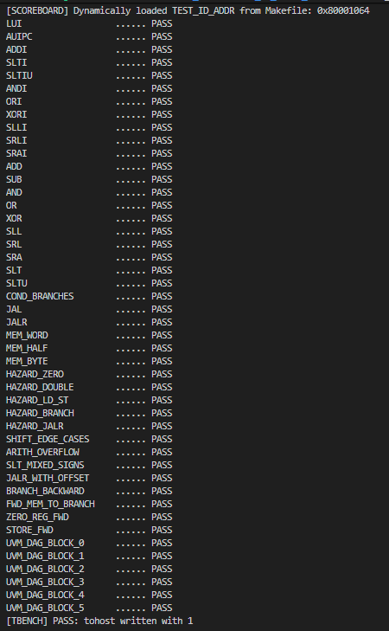
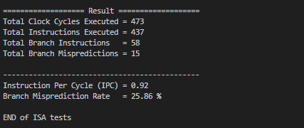
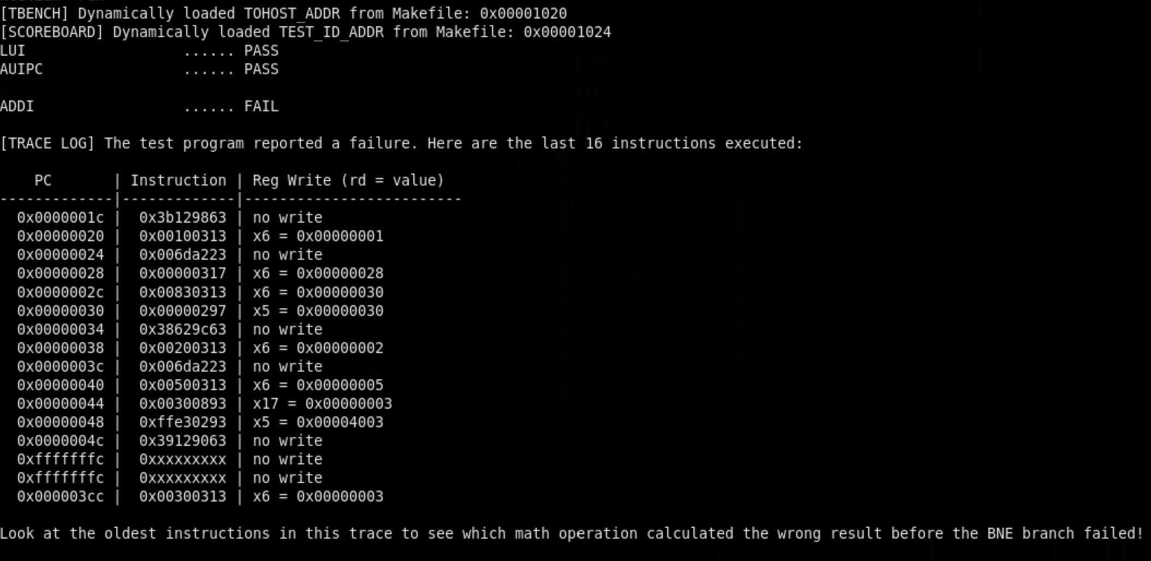
4. Results, Analysis & Conclusion
PASS Test
Performance Metrics
FAIL Test
5
FINAL LAB – Automated Verification – Group 4
4
FINAL LAB — RV32I Project Presentation

